Slide 1
Real hypersurfaces with constant principal curvatures in complex projective and hyperbolic spaces
Workshop on Hypersurface Geometry and Integrable Systems
Sendai 2010
Miguel Domínguez Vázquez (joint work with J. C. Díaz Ramos)
Departament of Geometry and Topology
University of Santiago de Compostela

Slide 2
Contents

Slide 3
Introduction
Homogeneous hypersurfaces vs. hypersurfaces
with constant principal curvatures
?

Slide 4
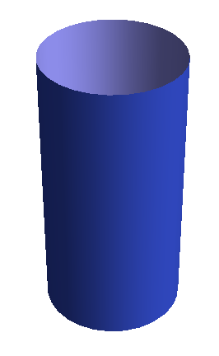
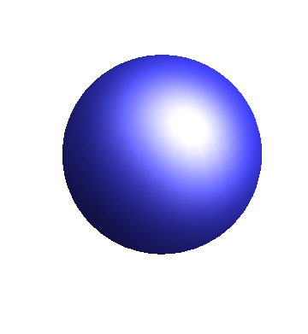
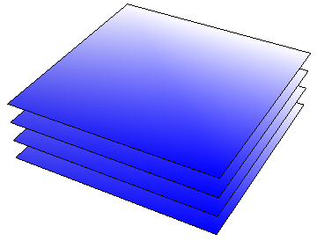
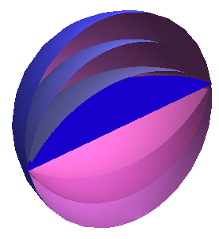
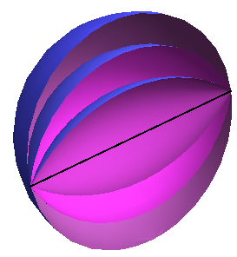
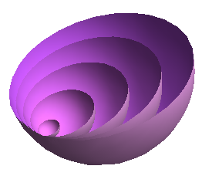
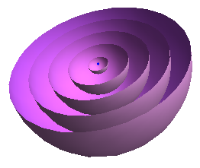
Introduction
The problem in space forms

Slide 5
Introduction
The problem in complex space forms

Slide 6
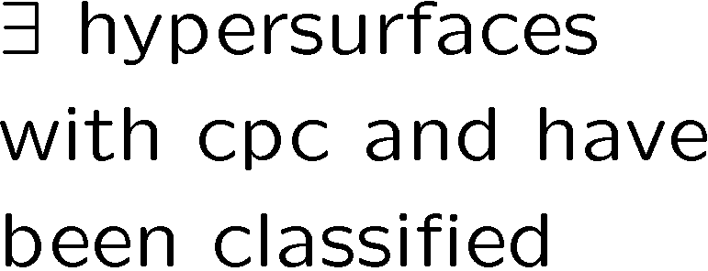
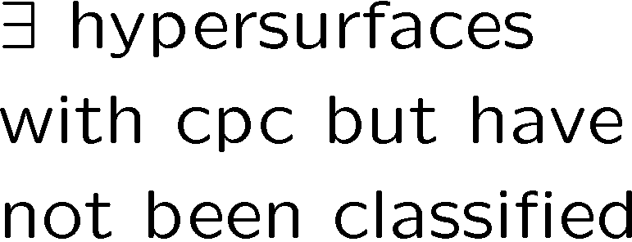
Introduction
The problem in complex space forms
g
g
 | 1 | 2 | 3 | 4 | 5 | > 5
1
2
3
4
5
> 5
 | 1 | 2 | 3 | 4 | 5 | > 5
1
2
3
4
5
> 5
h
h
?
?
?
?

Slide 7
as a symmetric space
Root space and Iwasawa decompositions

Slide 8
as a symmetric space
The submanifolds W^{2n-k}

Slide 9
Main Theorem

Slide 10
Main Theorem
Idea of the proof

Slide 11
Main Theorem

Slide 12
Contents

Slide 13
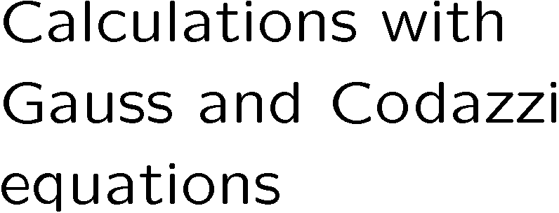
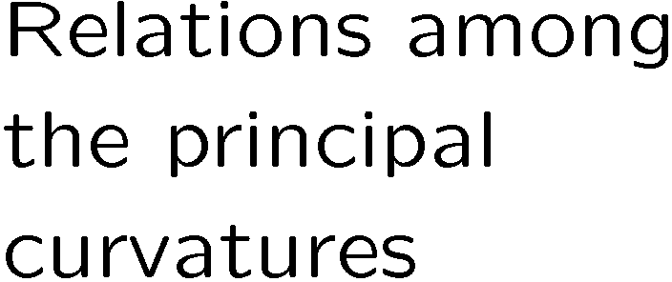
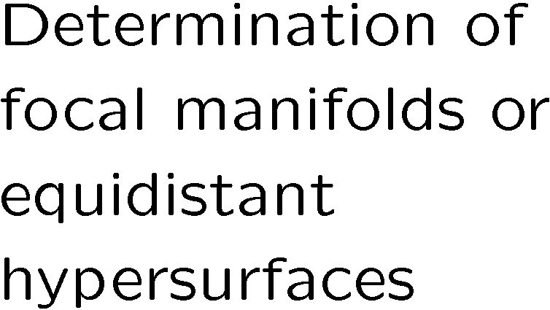
Main Theorem
Idea of the proof

