Slide 1

Isoparametric foliations on complex projective spaces
Differential Geometry Days
In honour of Luis A. Cordero
Miguel Domínguez Vázquez
Department of Geometry and Topology
University of Santiago de Compostela

Slide 2
Contents

Slide 3



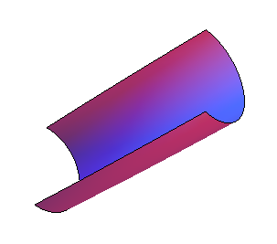
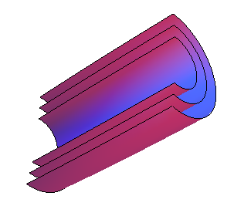
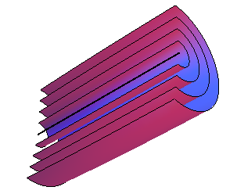
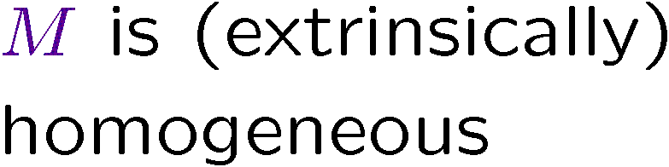
Isoparametric hypersurfaces
Isoparametric and homogeneous
hypersurfaces

Slide 4





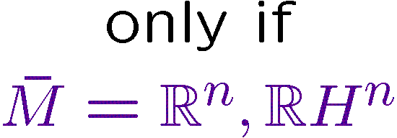
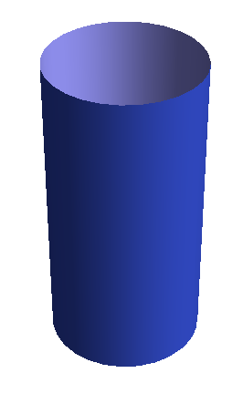
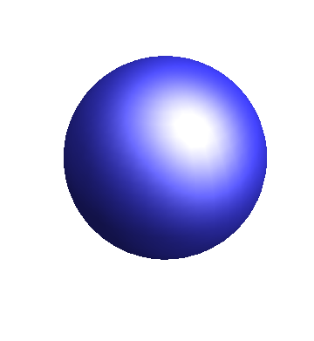
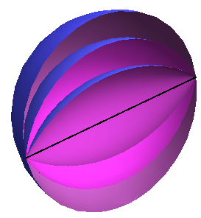
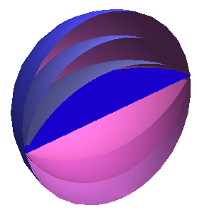
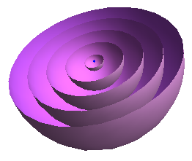
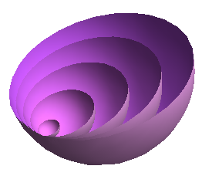
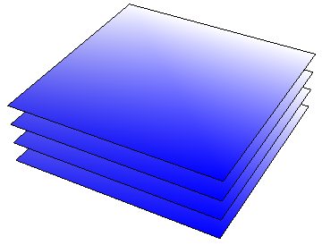


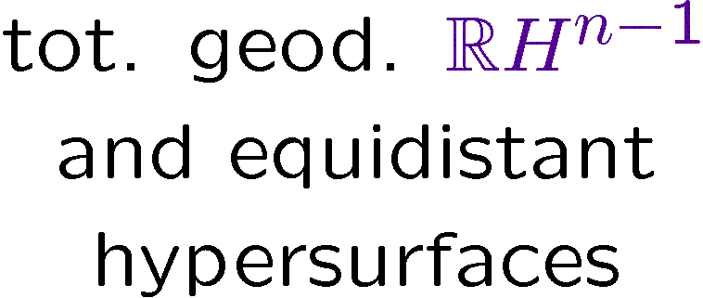
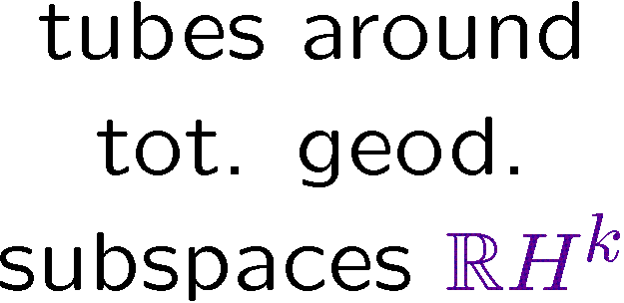


Isoparametric hypersurfaces
The classification in space forms

Slide 5










Isoparametric hypersurfaces
The classification in space forms

Slide 6


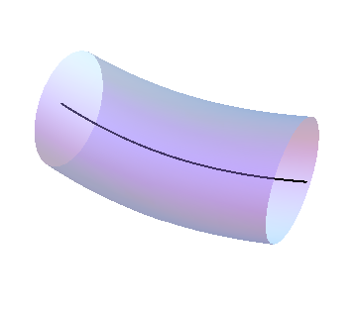
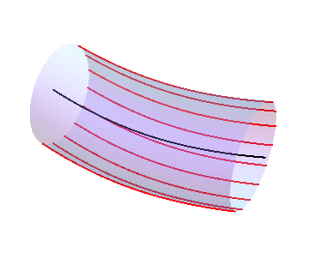
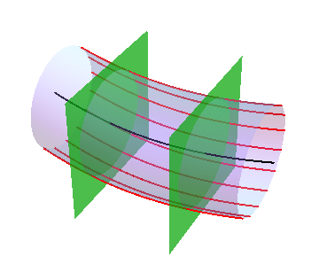
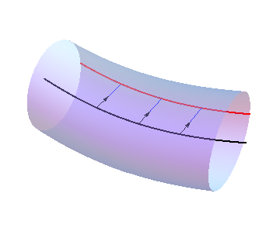
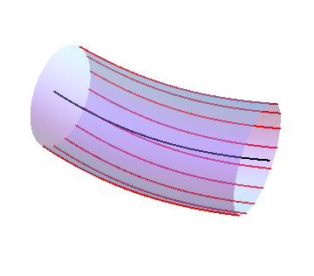
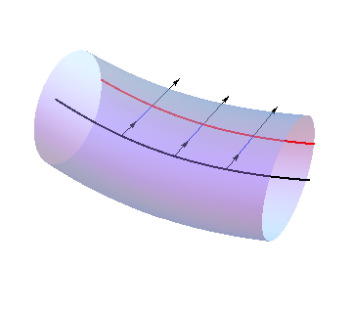
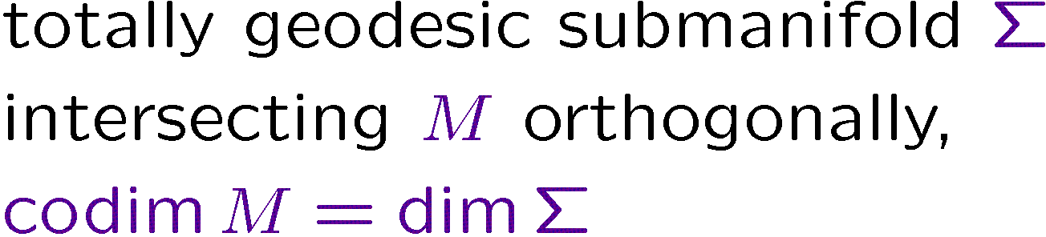




Isoparametric submanifolds
Definition and the problem in real space forms

Slide 7






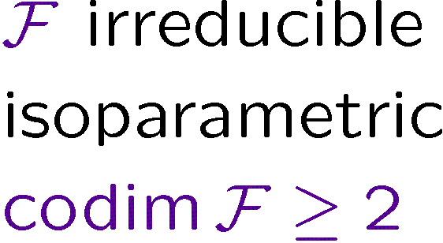
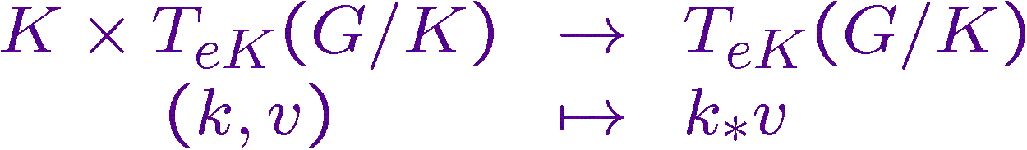
Isoparametric submanifolds
Definition and the problem in real space forms

Slide 8










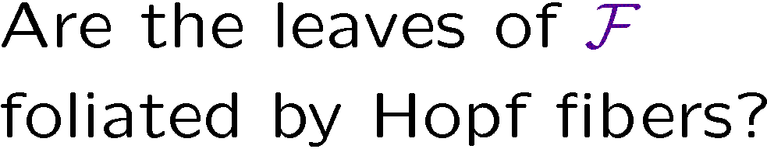

Isoparametric foliations on CP^{n}
The idea

Slide 9



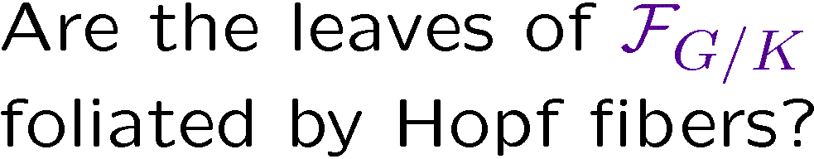






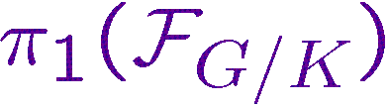

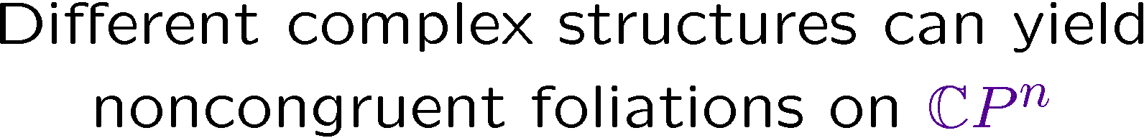

Isoparametric foliations on CP^{n}
The idea
?
NO
…
≈
/
≈
/

Slide 10

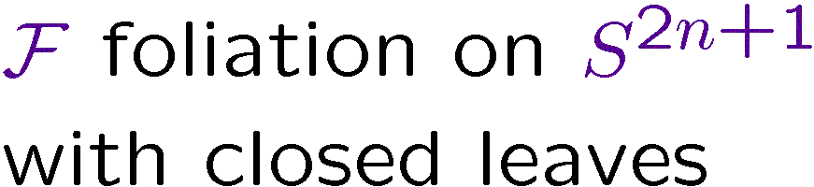

Isoparametric foliations on CP^{n}
Complex structures preserving a foliation

Slide 11



Isoparametric foliations on CP^{n}
Complex structures preserving a foliation

Slide 12
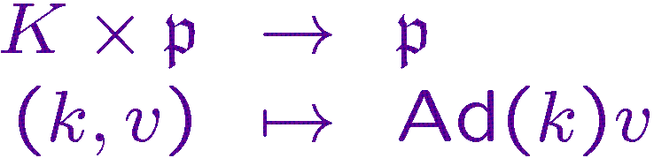



Isoparametric foliations on CP^{n}
Complex structures preserving a foliation

Slide 13

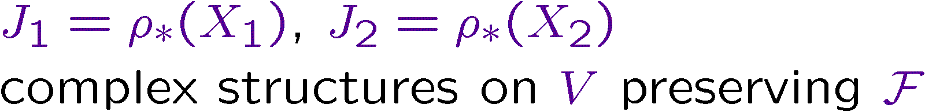









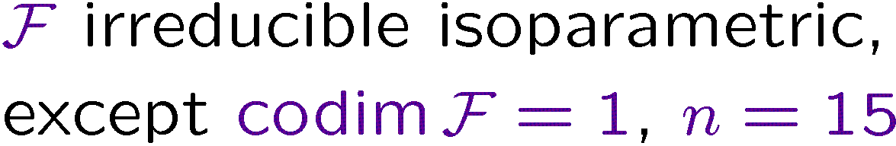

Isoparametric foliations on CP^{n}
Congruence of projected foliations
~
~
~

Slide 14


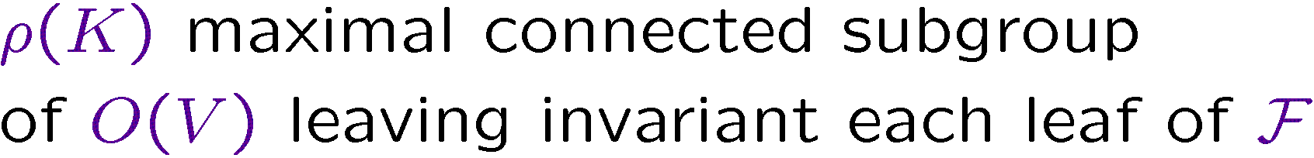






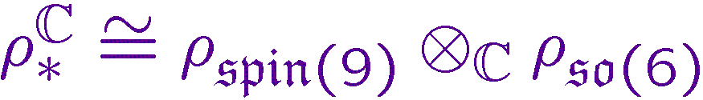
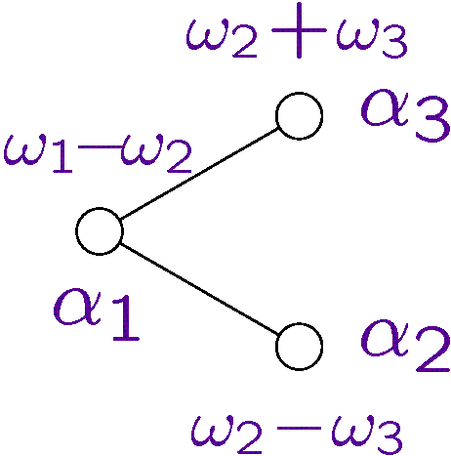
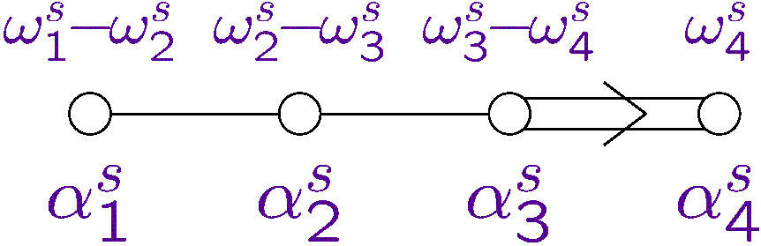
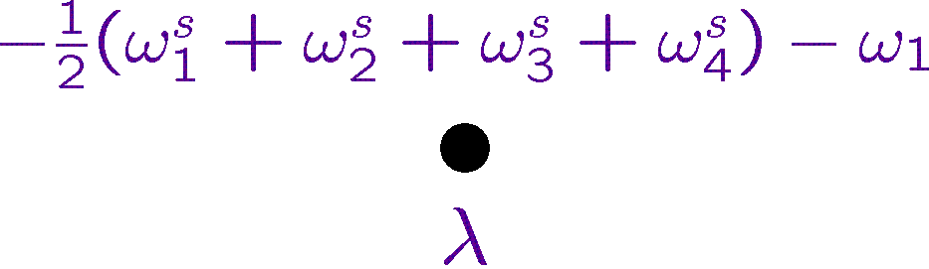
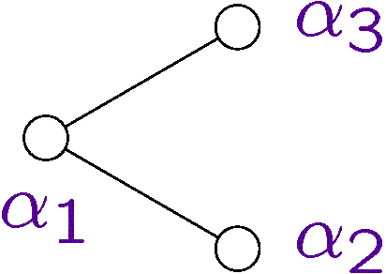
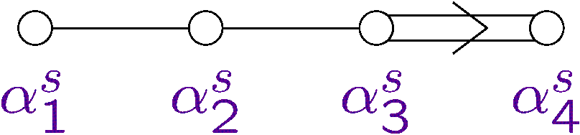

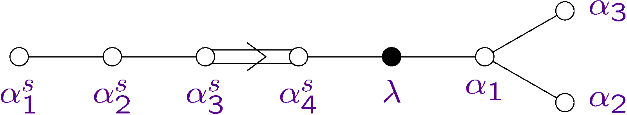
Isoparametric foliations on CP^{n}
Lowest weight diagrams and extended Vogan diagrams

Slide 15





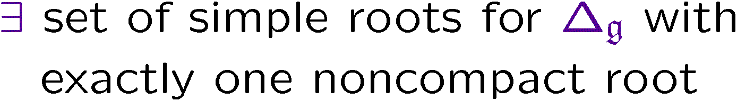

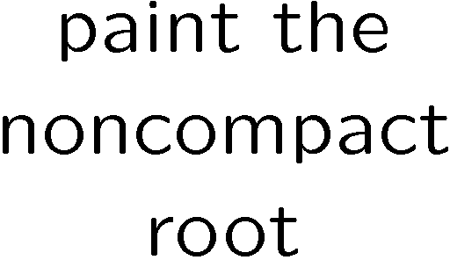
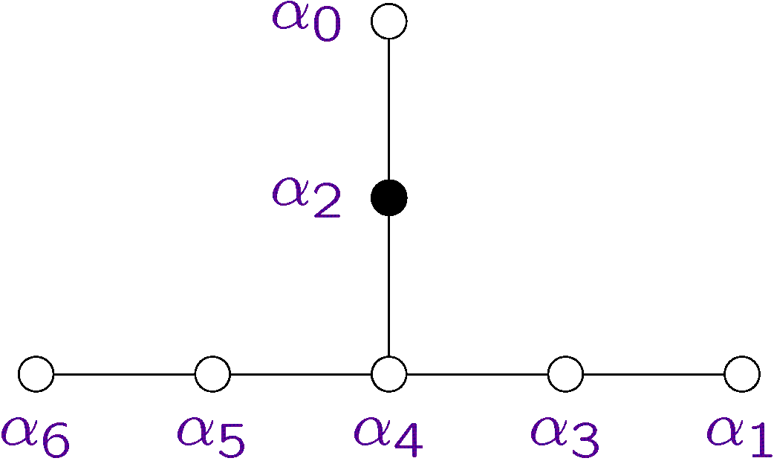
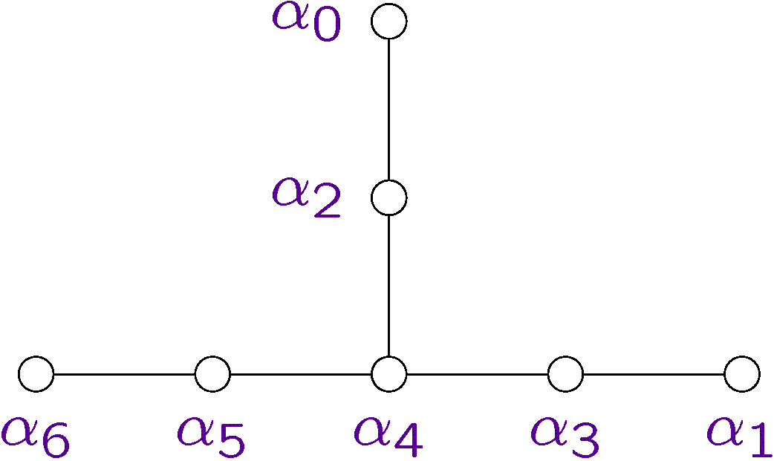


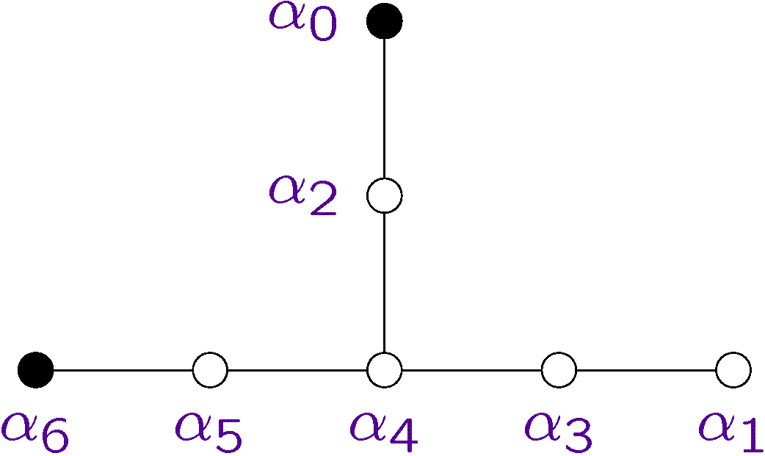
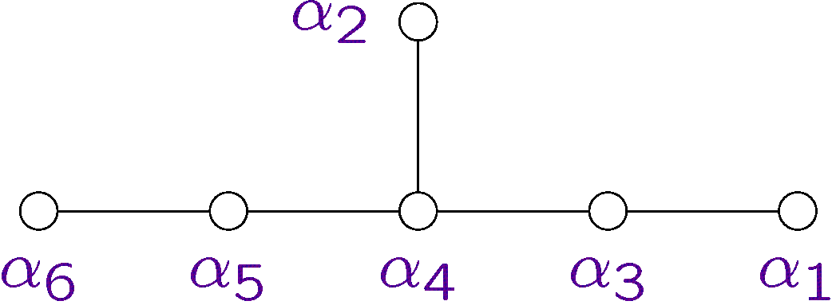

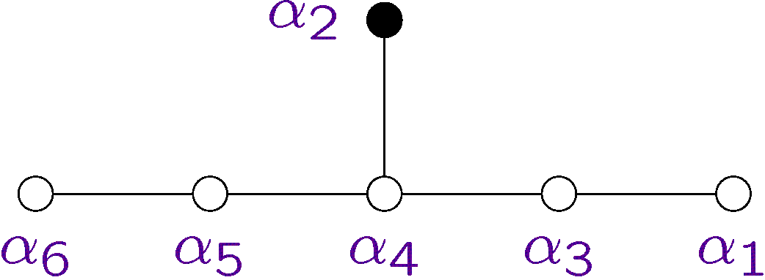
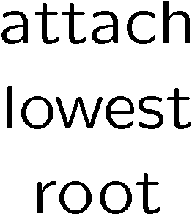
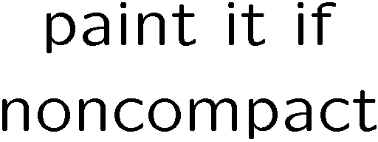
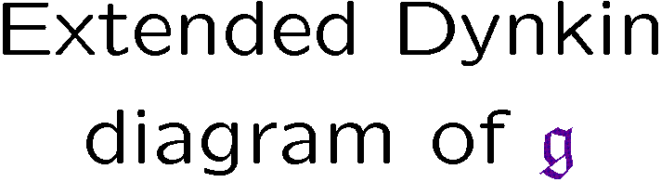





Isoparametric foliations on CP^{n}
Lowest weight diagrams and extended Vogan diagrams

Slide 16


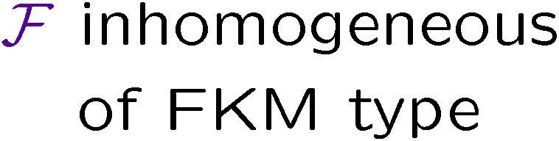









Isoparametric foliations on CP^{n}
Criterion for homogeneity.
Inhomogeneous examples
?

Slide 17





Isoparametric foliations on CP^{n}
Criterion for homogeneity.
Inhomogeneous examples
?

Slide 18
Thanks!

Slide 19

Isoparametric foliations on CP^{n}
Classification: projections of homogeneous polar foliations I

Slide 20

Isoparametric foliations on CP^{n}
Classification: projections of homogeneous polar foliations II

Slide 21

Isoparametric foliations on CP^{n}
Classification: projections of FKM-foliations I

Slide 22

Isoparametric foliations on CP^{n}
Classification: projections of FKM-foliations II

