Slide 1
Principal curvatures of isoparametric hypersurfaces in complex hyperbolic spaces
Conference in Geometry and Global Analysis
Celebrating P. Gilkey’s 65th Birthday
Miguel Domínguez Vázquez
joint work with J. Carlos Díaz Ramos
Department of Geometry and Topology
University of Santiago de Compostela

Slide 2
Contents

Slide 3
Isoparametric hypersurfaces
Basic definitions and notation

Slide 4
Isoparametric hypersurfaces
A problem in Geometric Optics

Slide 5
Isoparametric hypersurfaces
General results

Slide 6
Isoparametric hypersurfaces
Homogeneous hypersurfaces
?

Slide 7
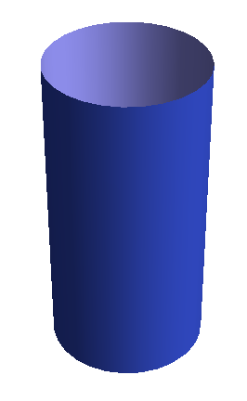
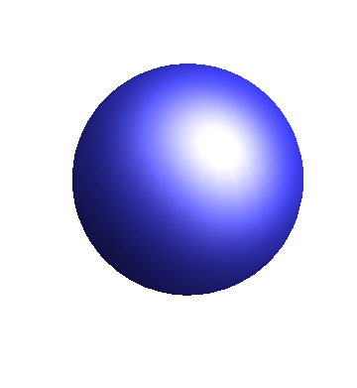
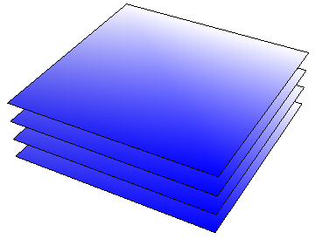
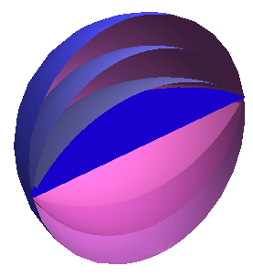
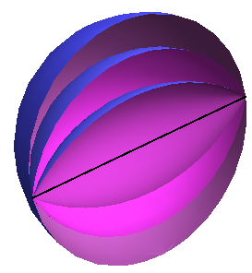
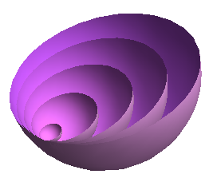
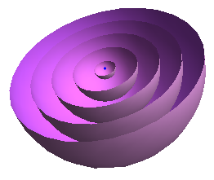
Isoparametric hypersurfaces
The classification in space forms

Slide 8
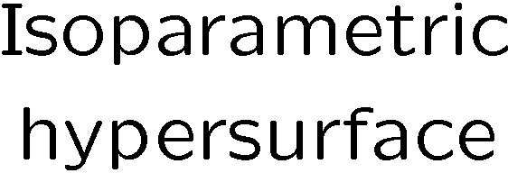
Isoparametric hypersurfaces
Generalization to more general ambient spaces

Slide 9
The problem in CP^{n} and CH^{n}
Basic definitions

Slide 10
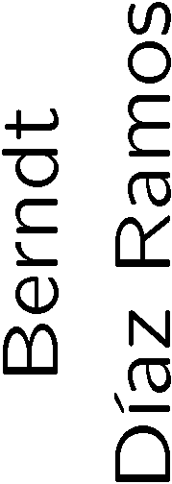
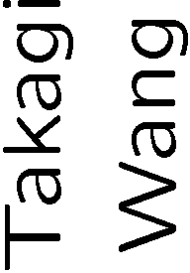
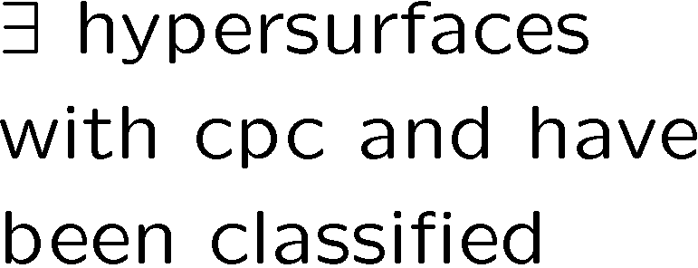
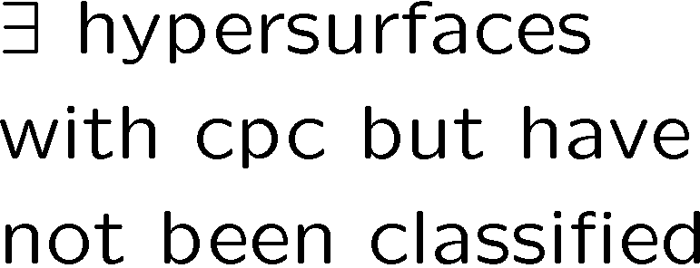
The problem in CP^{n} and CH^{n}
Real hypersurfaces with constant principal curvatures
g
g
 | 1 | 2 | 3 | 4 | 5 | > 5
1
2
3
4
5
> 5
 | 1 | 2 | 3 | 4 | 5 | > 5
1
2
3
4
5
> 5
h
h
?
?
?
?

Slide 11
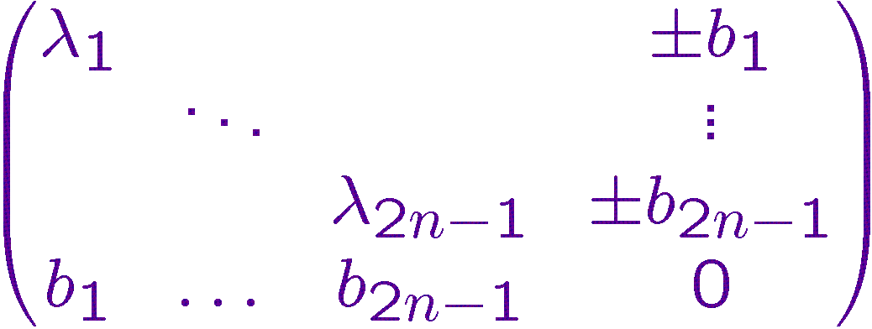
Behaviour of isoparametric hypersurfaces with respect to Hopf fibrations
The problem in CP^{n} and CH^{n}

Slide 12
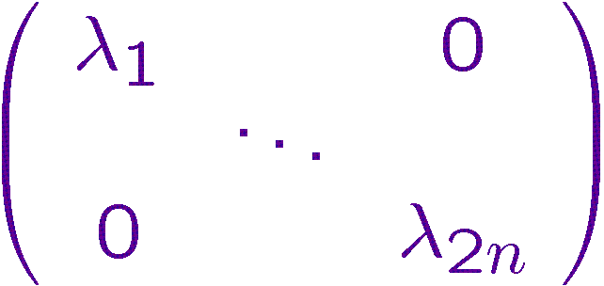
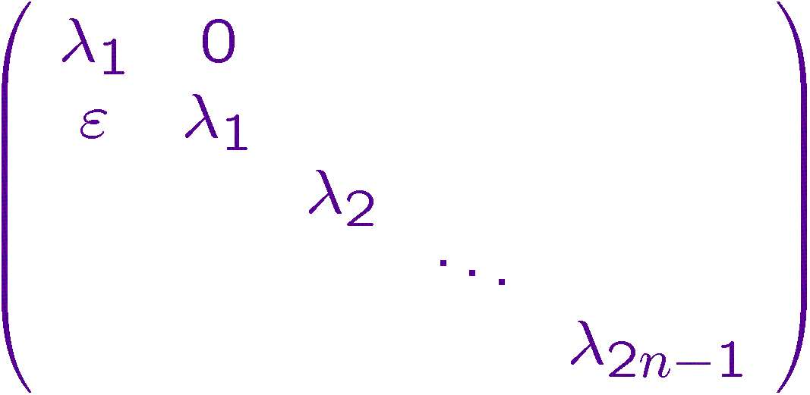
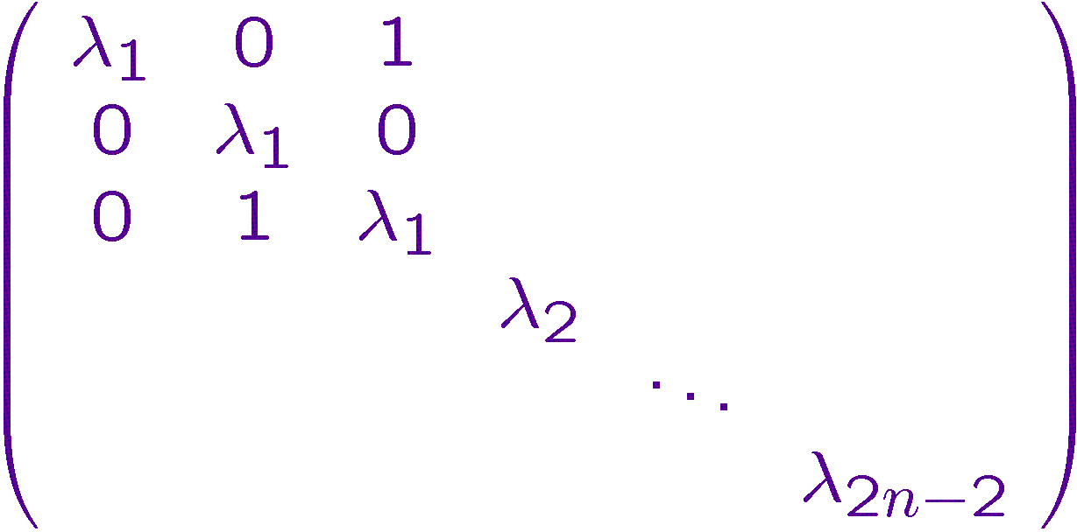
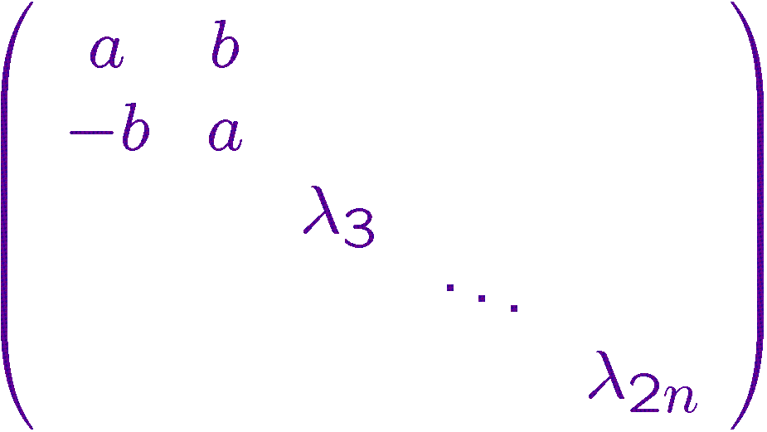
The problem in CH^{n}
Homogeneous hypersurfaces in CH^{n}

Slide 13
The problem in CH^{n}
Isoparametric hypersurfaces in CH^{n}

Slide 14
The problem in CH^{n}
Isoparametric hypersurfaces in CH^{n}
NO

Slide 15
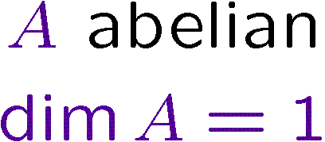
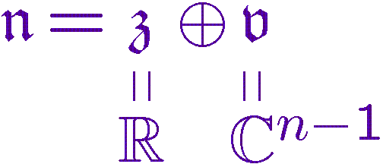
The problem in CH^{n}
New isoparametric hypersurfaces

Slide 16
The problem in CH^{n}
New isoparametric hypersurfaces

Slide 17
Thanks for your attention!

