Slide 1

On isoparametric hypersurfaces in complex hyperbolic spaces
International Meeting on Differential Geometry, Córdoba 2010
Miguel Domínguez Vázquez
(joint work with J. Carlos Díaz Ramos)
Department of Geometry and Topology
University of Santiago de Compostela

Slide 2
Contents

Slide 3






Isoparametric hypersurfaces
Basic definitions and notation

Slide 4

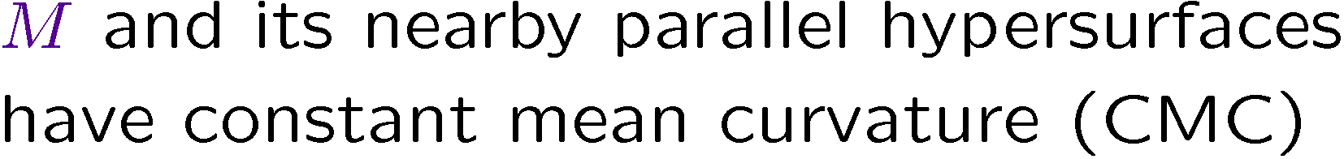


Isoparametric hypersurfaces
General results
?

Slide 5







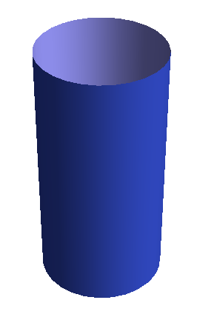
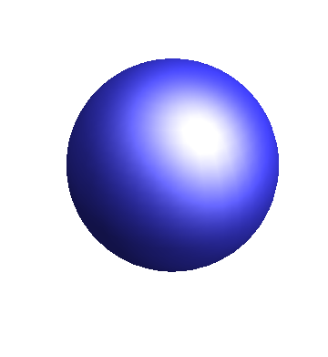
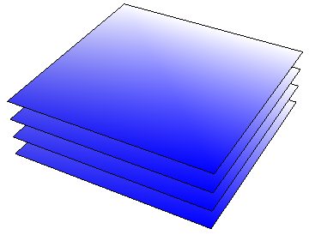
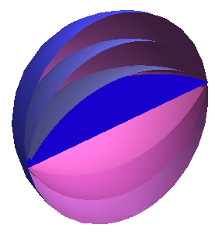
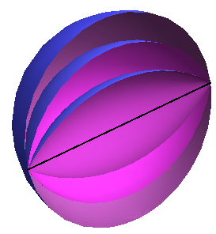
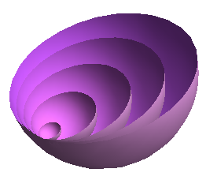
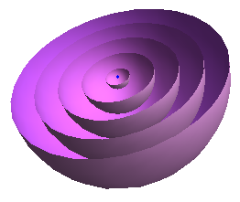
Isoparametric hypersurfaces
The problem in space forms

Slide 6




Isoparametric hypersurfaces
Generalization to more general ambient spaces

Slide 7











The problem in CP^{n} and CH^{n}
Basic definitions

Slide 8




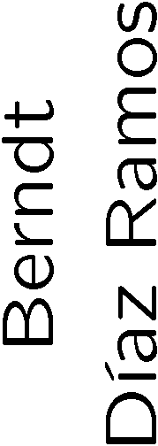

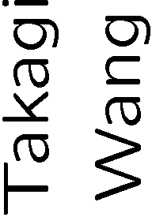





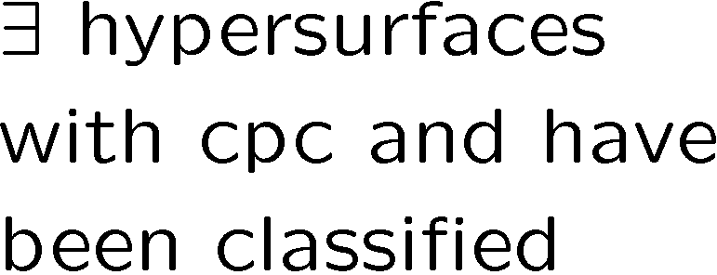
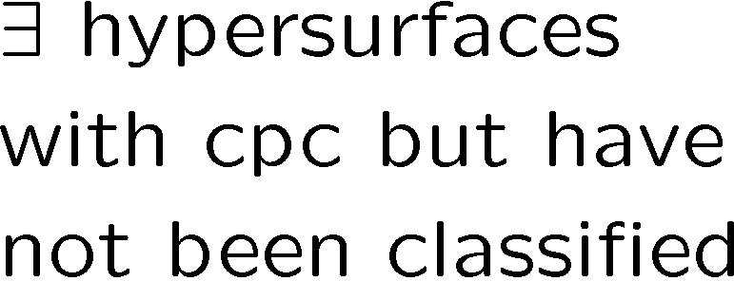
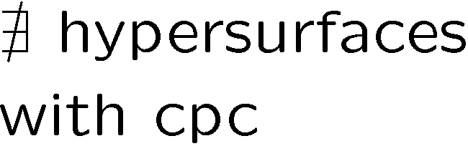
The problem in CP^{n} and CH^{n}
Real hypersurfaces with constant principal curvatures
g
g
 | 1 | 2 | 3 | 4 | 5 | > 5
1
2
3
4
5
> 5
 | 1 | 2 | 3 | 4 | 5 | > 5
1
2
3
4
5
> 5
h
h
?
?
?
?

Slide 9











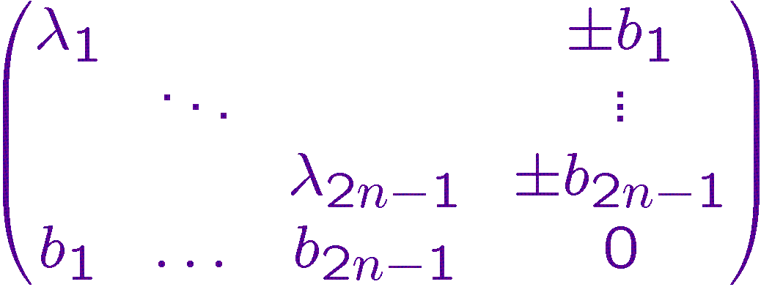

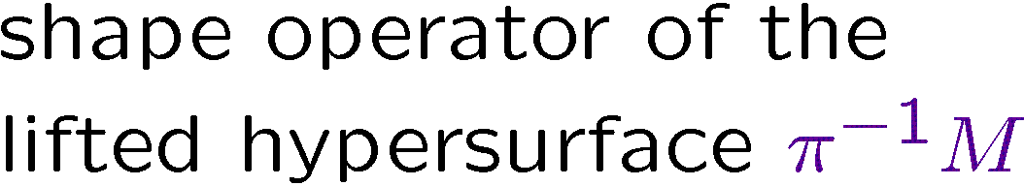
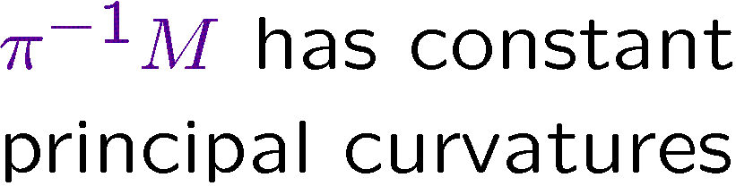


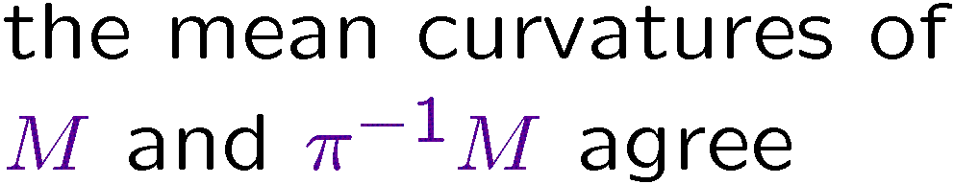
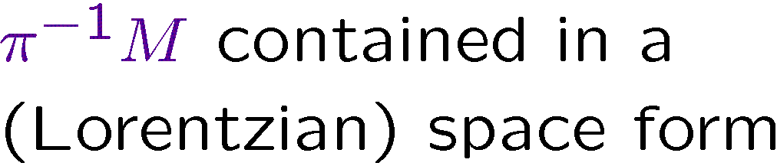
Behaviour of isoparametric hypersurfaces with respect to Hopf fibrations
The problem in CP^{n} and CH^{n}

Slide 10

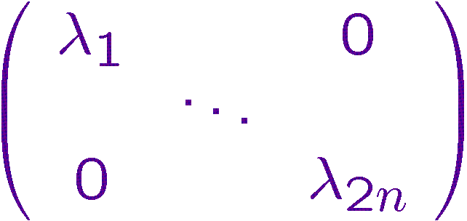
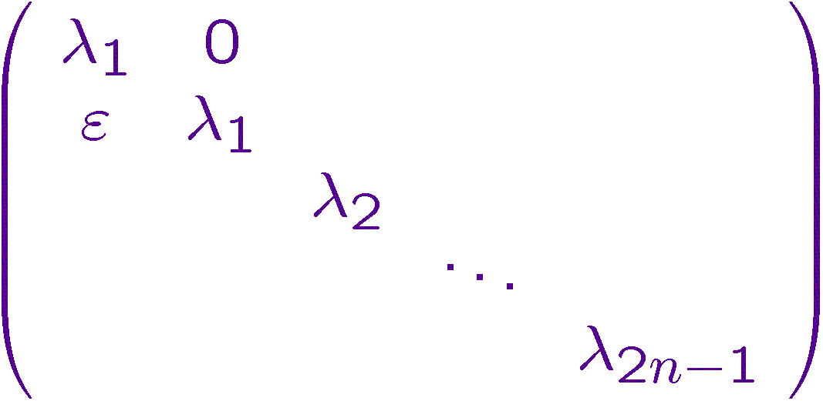


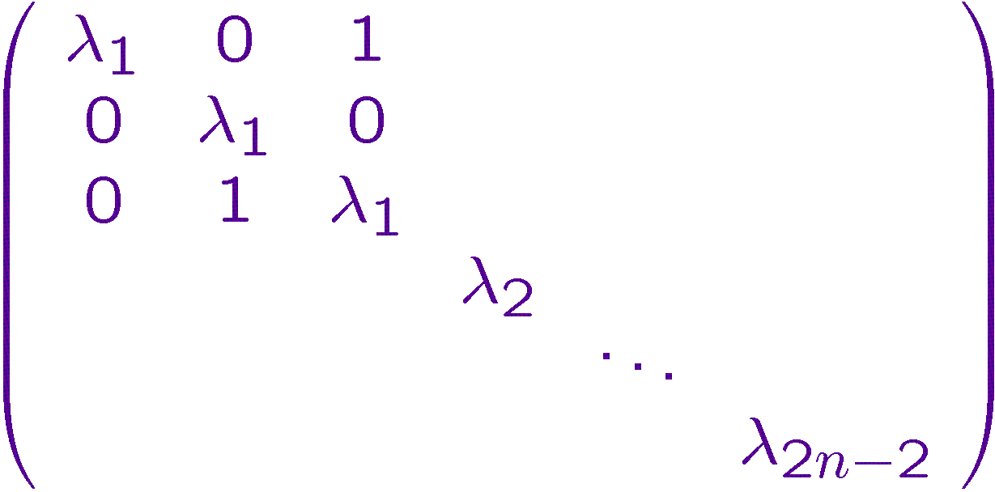

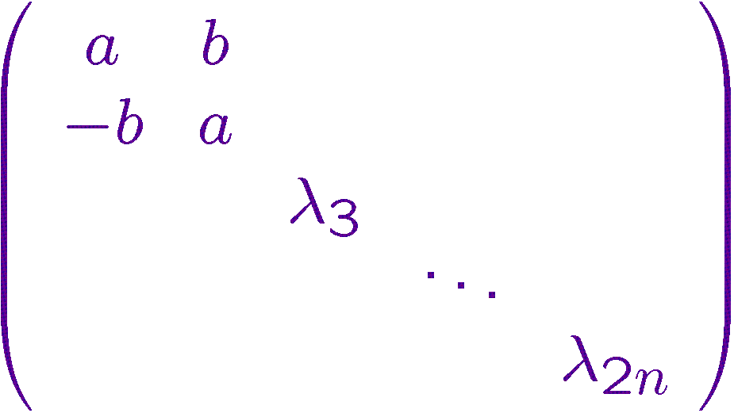

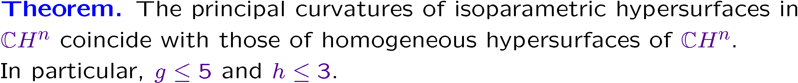
The problem in CH^{n}
Isoparametric hypersurfaces in CH^{n}

Slide 11


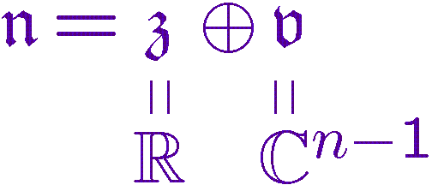
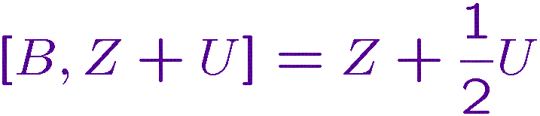





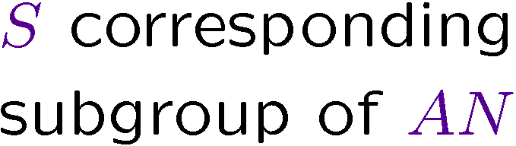




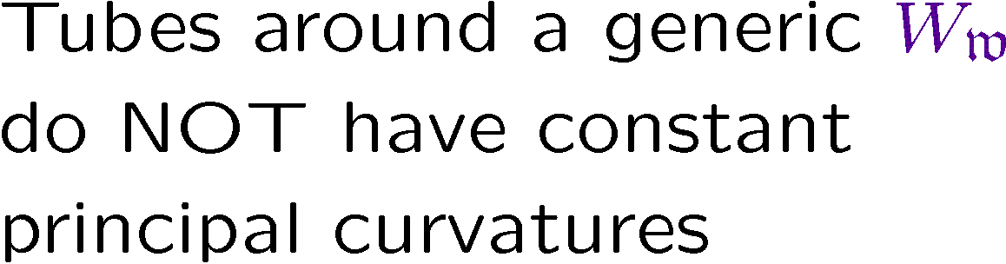

The problem in CH^{n}
New isoparametric hypersurfaces

Slide 12
Thanks for your attention!

