Slide 1

Polar actions on complex hyperbolic spaces
Joint work with J. C. Díaz-Ramos and A. Kollross
Miguel Domínguez Vázquez
Instituto de Matemática Pura e Aplicada

Slide 2




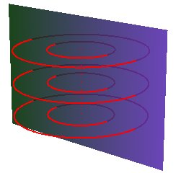
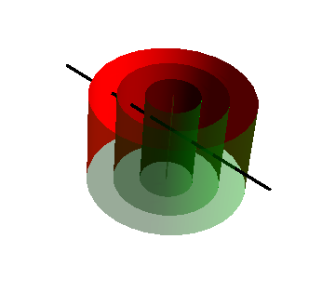
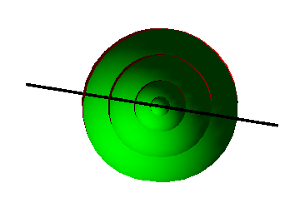
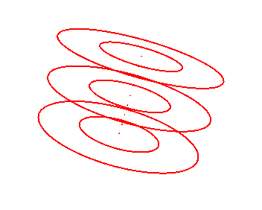
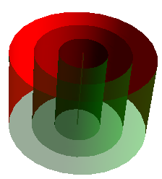
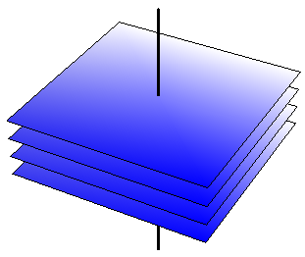
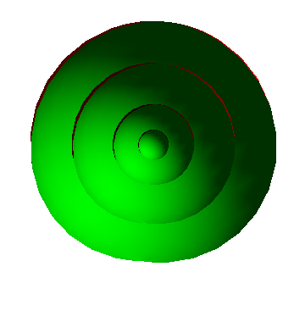
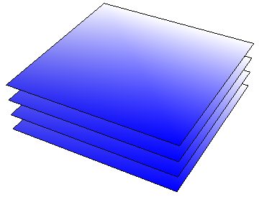
Symmetry in submanifold theory

Slide 3


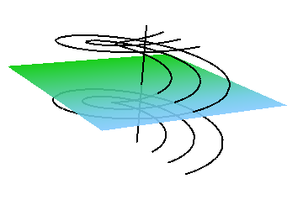
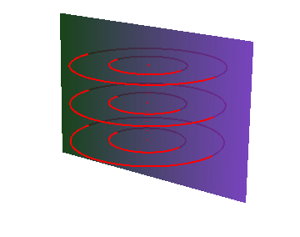

Polar actions
Definition

Slide 4








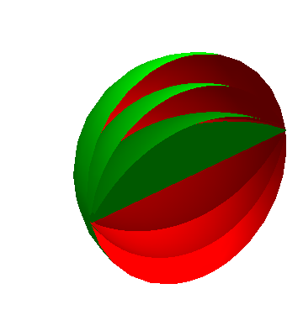

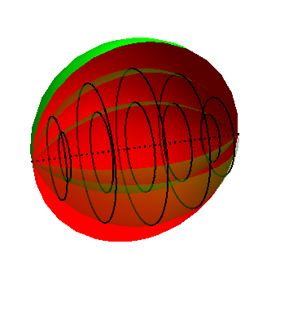
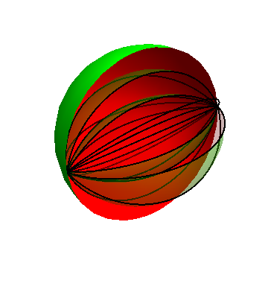
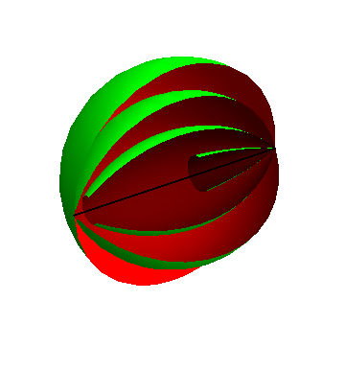
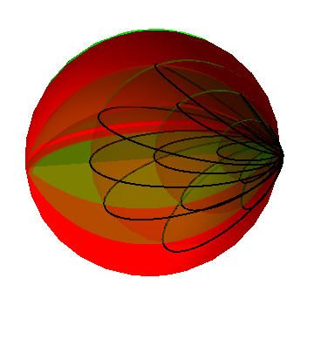
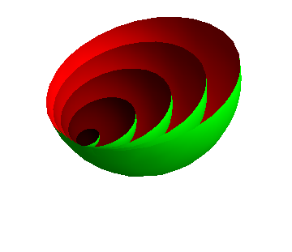
Polar actions
Previous classification results

Slide 5




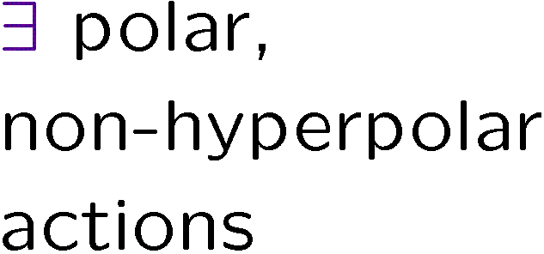











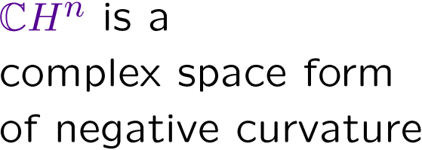



Polar actions
Previous classification results

Slide 6


Polar actions on CH^{n}
Sketch of the proof

Slide 7



Polar actions on CH^{n}
Sketch of the proof

Slide 8









Polar actions on CH^{n}
Sketch of the proof

Slide 9








Polar actions on CH^{n}
Sketch of the proof

Slide 10







Polar actions on CH^{n}
Classification theorem

